Slide 2

1. Introduction and Motivation
Why using acoustic signal for smartphone indoor localization?
GSM
GPS
FM
Camera
WiFi
BlueTooth
Accelerator
Magnetic
Microphone
Completely compatible with smartphone
High positioning accuracy
High positioning stability
Low cost
LMF signals
[K. Liu 2015] Kaikai Liu, Xinxin Liu, and Xiaolin Liu. Guoguo: Enabling Fine-grained Smartphone Localization via Acoustic Anchors. IEEE Transactions on Mobile Computing, 2015, 15(5):1-1.
[S. I. Lopes 2015] Sergio I. Lopes, Joes M.N. Vieira, Joao Reis, Daniel Albuquerque, and Nuno B. Carvalho. Accurate smartphone indoor positioning using a WSN infrastructure and non-invasive audio for TDoA estimation. Pervasive & Mobile Computing, 2015, 20(C):29-46.
[Alexander Ens 2015] Acoustic Self-Calibrating System for Indoor Smart Phone Tracking. International Journal of Navigation and Observation. 2015.
[Reimar Pfeil. 2015] Robust Acoustic Positioning for Safety Applications in Underground Mining. IEEE Transactions on Instrumentation and Measurement. Vol.64, No. 11, 2015.

Slide 3
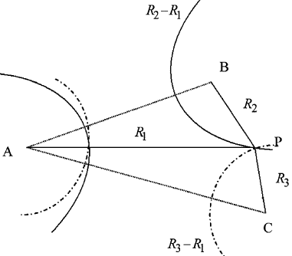
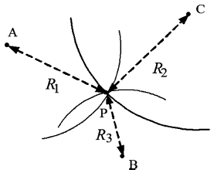
1. Introduction and Motivation
Technical bottleneck from laboratory to real world
High accurate ToA/TDoA estimation in dense multipath environment
None-Line-of-Sight in real world
ToA
TDoA
[Hui Liu 2007]Survey of Wireless Indoor Positioning Techniques and Systems. IEEE Transactions on Systems, Man and Cybernetics. Vol. 37, No.6, 2007

Slide 4
1. Introduction and Motivation
Present NLOS identification approaches
The range (TOA) statistics
Channel characteristics
The consistency between the ToA estimation and path loss for NLOS
For moving target
Need accurate Channel Coefficients and Path Delays
Need different location technology
[Roee Diamant 2014] LOS and NLOS Classification for Underwater Acoustic Localization. IEEE Transactions on Mobile Computing. Vol.13, No.2, 2014

Slide 5
1. Introduction and Motivation
Motivation
信号ToA估计与NLOS判别一直都是独立分开进行研究的。由于利用信道统计特性进行NLOS遮挡判别离不开对 First Arriving Path的 probability density function 的估计，而在进行ToA估计时，均是在对多径进行抑制的情况下，检测第一到达路径的到达时刻，而这两个过程是完全可以合并的。
又由于大多数针声音室内手机定位系统采用LFM信号，因此，本文提出一种新的基于FrFT的高精度ToA 估计及NLOS判别方法：即通过精确First arriving path的 channel coefficients and path delays，来进行ToA估计以及NLOS判别。

Slide 6
1. Introduction and Motivation
Contribution
将ToA估计以及NLOS判别问题，合并为 channel coefficients and path delays estimation的问题。并利用channel characteristics实现ToA的精确估计以及NLOS的判别，有效地解决了声音室内手机定位技术中的瓶颈。
针对LFM信号，提出一种带有递归最优阶数估计器及自适应阈值决策的FrFT估计方法，能够有效获得channel coefficients and path delays 及ToA估计值，并通过在地下停车场的测距实验，表明基于ToA的测距的精度和鲁棒性得到明显改善。
给出了室内、走廊及大厅三种环境的信道统计特性，如：平均时延、RMS时延展宽及Rician K因子等。

Slide 7
2. Signal modulation
Contribution

